Slide 1



CONFLICT
SERIALIZABILITY
Notes:
Welcome to my presentation on "Conflict Serializability" in the context of Database Management System.
My name is Chandana Galgali, and today, I will be discussing the concept of conflict serializability and its significance in ensuring the correctness and consistency of concurrent transactions.
Let's dive into the world of database management systems and explore the fascinating topic of conflict serializability.

Slide 2

Introduction
Conflict serializability is a crucial concept in database management systems that ensures the correctness and consistency of concurrent transactions.
It guarantees that the execution of concurrent transactions produces the same result as if they were executed serially.
Conflict serializability plays a vital role in maintaining data integrity and preventing anomalies in database systems.
Notes:
In the world of database management systems, conflict serializability plays a crucial role in maintaining data integrity and preventing anomalies in concurrent transactions.
Conflict serializability ensures that the execution of concurrent transactions produces the same result as if they were executed sequentially.
By guaranteeing serializability, we can ensure that the final state of the database remains consistent and reflects the correct outcome of the transactions.

Slide 3

Serializability
Serializability refers to the property of a schedule in which the execution of concurrent transactions appears as if they were executed sequentially, one after another.
It ensures that the final state of the database remains consistent and reflects the correct outcome of the transactions.
A schedule is a sequence of operations from different transactions, and it can be represented as a timeline.
Notes:
To understand conflict serializability, let's first grasp the concept of serializability itself.
Serializability refers to the property of a schedule in which the execution of concurrent transactions appears as if they were executed sequentially, one after another.
It ensures that the final state of the database remains consistent and reflects the correct outcome of the transactions.
A schedule is a sequence of operations from different transactions, and it can be represented as a timeline.

Slide 4

Serializable Schedules
Serializable schedules are those that are either conflict serializable or view serializable.
Conflict serializability ensures that the schedule is free from conflicts between operations.
View serializability ensures that the schedule produces the same results as a serial execution, considering the read and write dependencies.
It is important to ensure that schedules are serializable to maintain data consistency and integrity.
Notes:
It's important to understand that conflict serializability is just one aspect of serializability.
Serializable schedules are those that are either conflict serializable or view serializable.
Conflict serializability ensures that the schedule is free from conflicts between operations.
View serializability ensures that the schedule produces the same results as a serial execution, considering the read and write dependencies.
Both conflict serializability and view serializability are essential for maintaining data consistency and integrity.

Slide 5
Conflict Serializability
Conflict serializability is a specific type of serializability that focuses on the conflicts between operations in concurrent transactions.
Conflicting operations are those that access or modify the same data item and have a potential to create interference or inconsistency.
By analyzing the conflicts between operations, we can determine if a schedule is conflict serializable.
Notes:
Conflict serializability is a specific type of serializability that focuses on the conflicts between operations in concurrent transactions.
Conflicting operations are those that access or modify the same data item and have the potential to create interference or inconsistency.
By analyzing the conflicts between operations, we can determine if a schedule is conflict serializable.

Slide 6
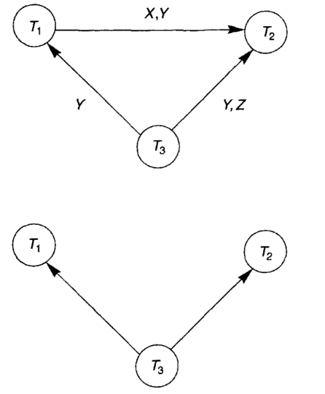
Precedence Graph
A precedence graph is a graphical representation used to determine conflict serializability in a schedule of transactions.
It focuses on the order of conflicting operations rather than the conflicts themselves.
In a precedence graph, nodes represent transactions or operations and directed edges represent the order of execution between conflicting operations.
Notes:
To determine conflict serializability, we use a graphical representation called the precedence graph.
The precedence graph focuses on the order of conflicting operations rather than the conflicts themselves.
Nodes in the precedence graph represent operations, and directed edges represent the order of execution.
We construct a precedence graph by examining the order of conflicting operations in the schedule.
Let's take a look at an example of a precedence graph to understand this concept better.

Slide 7

Testing for Conflict Serializability (Using precedence graphs)
For each transaction T_{i} participating in schedule S, create a node labeled T_{i} in the precedence graph.
For each case in S where T_{j} executes a read_item(X) after T_{i} executes a write_item(X), create an edge (T_{i} → T_{j}) in the precedence graph.
For each case in S where T_{j} executes a write_item(X) after T_{i} executes a read_item(X) , create an edge (T_{i} → T_{j}) in the precedence graph.
For each case in S where T_{j} executes a write_item(X) after T_{i} executes a write_item(X), create an edge (T_{i} → T_{j}) in the precedence graph.
The schedule S is serializable if and only if the precedence graph has no cycles.
Notes:
In the context of a schedule S, we can construct a precedence graph to analyze the order of conflicting operations.
The precedence graph helps us understand the dependencies between transactions and their execution order.
To construct the precedence graph, we follow a few simple rules.
For each transaction Ti participating in schedule S, we create a node labeled Ti in the precedence graph. This represents each transaction as a distinct node in the graph.
Next, we examine the schedule S and identify cases where Tj executes a read_item(X) after Ti executes a write_item(X). In such cases, we create an edge (Ti → Tj) in the precedence graph. This indicates that Ti must be executed before Tj to maintain the correct order of operations.
Similarly, we identify cases where Tj executes a write_item(X) after Ti executes a read_item(X). In these cases, we create an edge (Ti → Tj) in the precedence graph, signifying that Ti must be executed before Tj.
Lastly, we consider cases where Tj executes a write_item(X) after Ti executes a write_item(X). Here, we create an edge (Ti → Tj) in the precedence graph, indicating that Ti must be executed before Tj to maintain the correct order of write operations.
Once we have constructed the precedence graph, we can analyze it to determine the serializability of the schedule S. If the precedence graph has no cycles, then the schedule S is serializable. On the other hand, if the graph contains cycles, the schedule is not serializable.
The absence of cycles in the precedence graph ensures that there are no conflicting dependencies that violate the serializability of the schedule. It guarantees that the execution of transactions in the schedule can be rearranged to produce an equivalent serial execution.

Slide 8
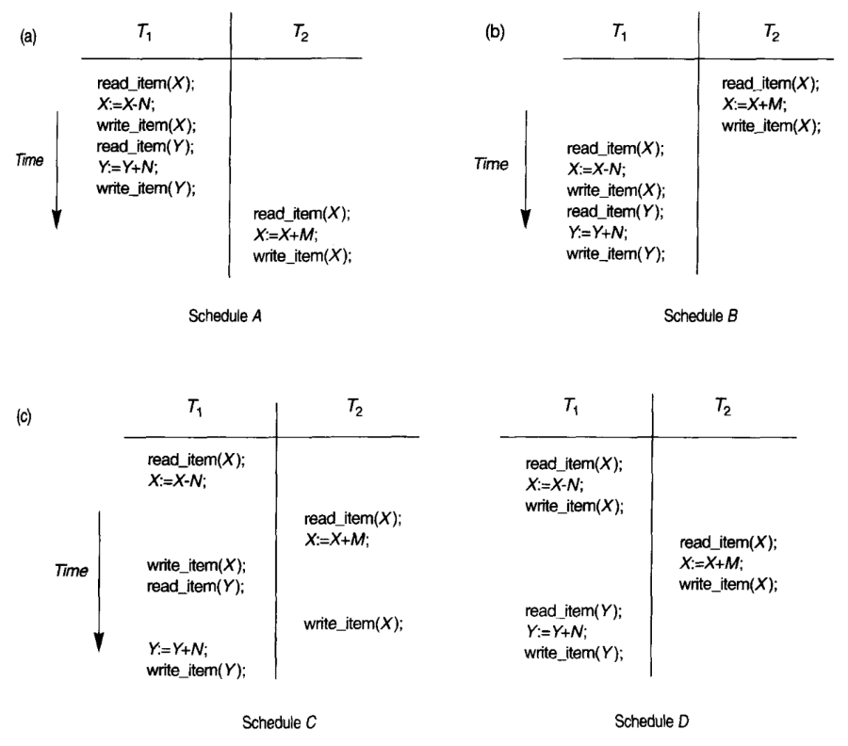
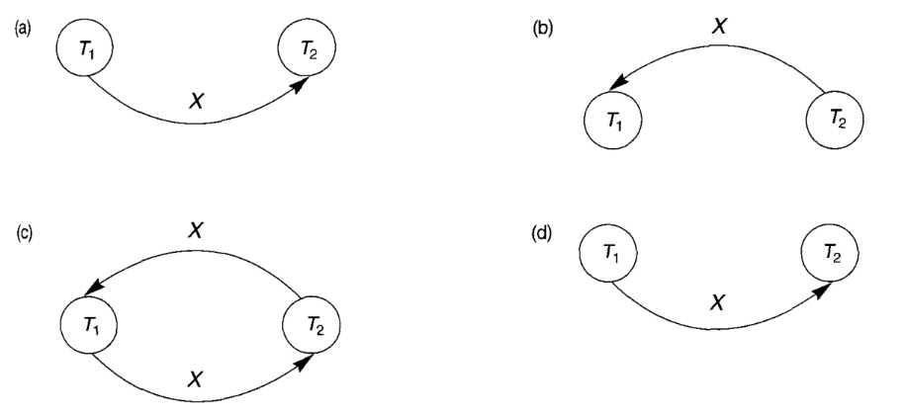
Testing for Conflict Serializability (Using precedence graphs)
Schedules A, B and D are conflict serializable because their respective precedence graphs are acyclic; whereas schedule C is not because its respective precedence graph is cyclic.
Notes:
To further illustrate the concept of precedence graphs and their role in determining serializability, let's examine an example schedule and its corresponding precedence graph.
By following the steps given in the previous slide, we can construct the precedence graph for the given schedule. The precedence graph visually represents the order of conflicting operations and their dependencies.
Analyzing the precedence graph, we can determine the serializability of the schedule. If the graph contains no cycles, then the schedule is serializable. However, if cycles exist in the graph, the schedule is not serializable.

Slide 9
Advantages
Disadvantages
Consistency
Correctness
Reduced Overhead
Improved Concurrency
Complexity
Reduced Performance
Limited Concurrency
Increased Overhead
Notes:
Advantages of conflict serializability:
Conflict serializability ensures that the results of the transactions are consistent with the order in which they were executed.
It also ensures that the execution of transactions is correct, regardless of the order in which they were submitted.
Conflict serializability reduces overhead by eliminating unnecessary locking and other conflict resolution mechanisms.
It improves concurrency by allowing transactions to execute simultaneously without conflicting with each other.
Disadvantages of conflict serializability:
Conflict serializability can be complex to implement, especially in large and complex databases.
It can reduce performance by introducing delays and overhead due to locking and other conflict resolution mechanisms.
Conflict serializability can limit the degree of concurrency in the system because it may delay some transactions to avoid conflicts.
It also requires additional overhead to maintain the order of the transactions and ensure that they do not conflict with each other.

Slide 10
Conclusion
Conflict serializability is a crucial concept in database management systems to ensure the correctness and consistency of concurrent transactions.
By analyzing conflicts between operations using conflict graphs or precedence graphs, we can determine if a schedule is conflict serializable.
Serializable schedules are essential for maintaining data integrity and preventing anomalies in database systems.
References:
Elmasri and Navathe, “ Fundamentals of Database Systems”, 4thEdition, PEARSON Education
Name: Chandana Ramesh Galgali
Roll Number: 16010422234
Notes:
In conclusion, conflict serializability is a crucial concept in database management systems to ensure the correctness and consistency of concurrent transactions.
By analyzing conflicts between operations using precedence graphs, we can determine if a schedule is conflict serializable.
Serializable schedules are essential for maintaining data integrity and preventing anomalies in database systems.
I hope this presentation has provided valuable insights into the concept of conflict serializability in database management systems.
Here is the reference I used in preparing this presentation.
This source can be explored for further information on conflict serializability and related topics.
Thank You!

